Slide 1
Chaos Stones vol II

Slide 2
Before you watch the Volume I...
The mew threes(based of mew twos)were designed by vaporeon249 (exept hunt)http://vaporeon249.deviantart.com/ is his page.
read top to bottom, left to right.
The mewthree,with reznor was created by psylady her page http://psylady.deviantart.com/.
Do not own the music,any of it,its all owned by FUNimantions

Slide 3
on the last volume
Chaos Stones vol I

Slide 4
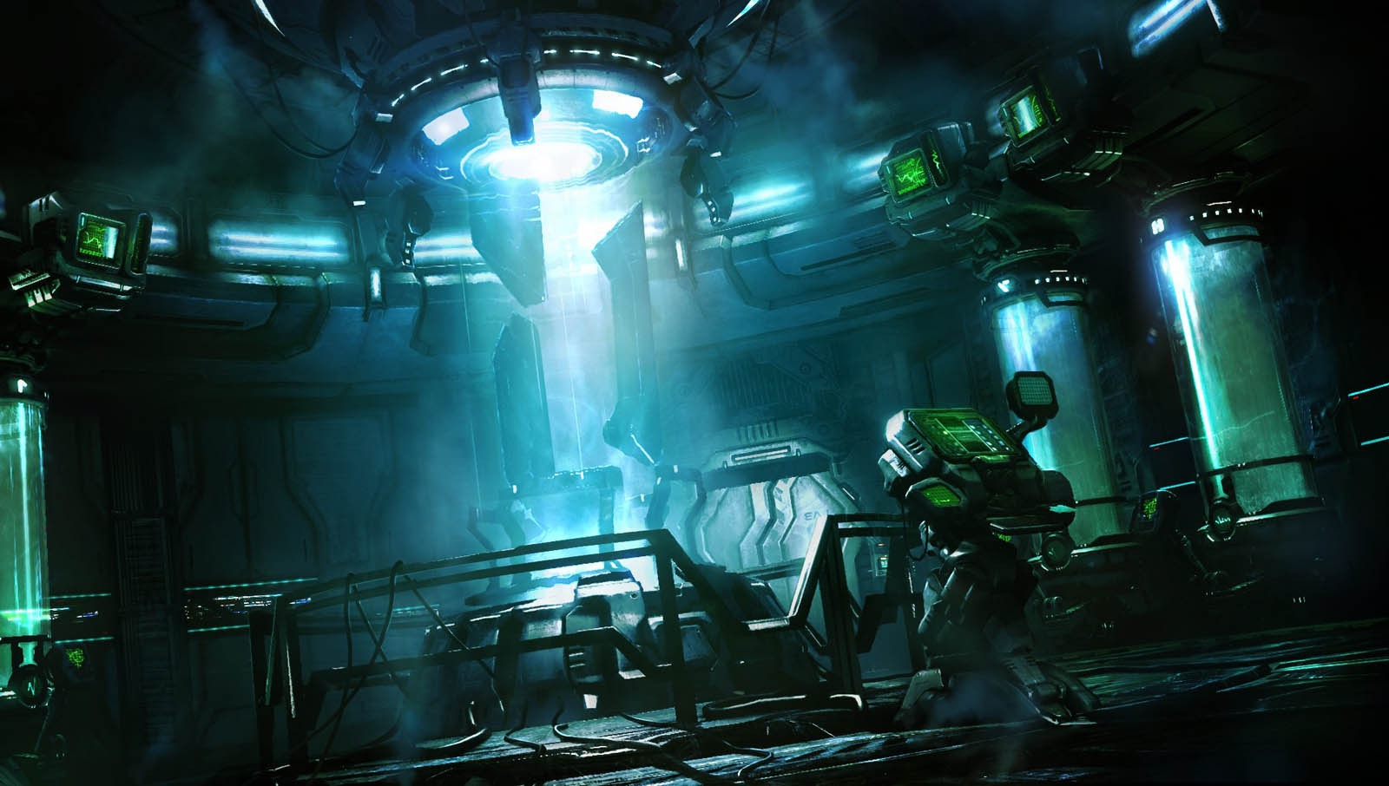
Ah...Mewblade you are finally complete...
After brainwashing you, i can now control all that i have wished for...to destroy demisewan,hunt and the creature that has infected me!

Slide 5
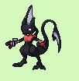
Have a closer look, my brother and sister
What took you so long...
Be quite you fool,i’ll kill you for leaving me behind...
What you on about sis...
Shut up and battle
Demisewan stay out of this if i fall atleast we got you,fly to the mansion

Slide 6
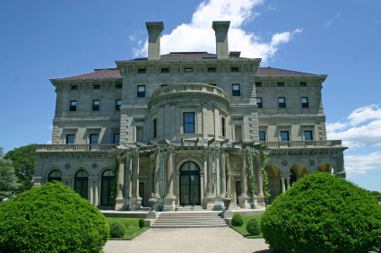
Hey demisewan
Hey reznor
How was the beach
It wasnt good...mewblade came back,but shes different ,she seemed
That shes been brain washed to kill us,but who would do shuch things to her an us...

Slide 7
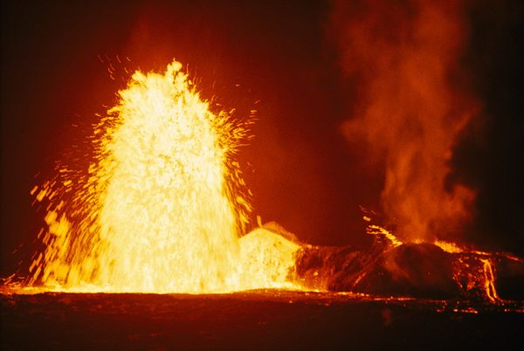

Slide 8
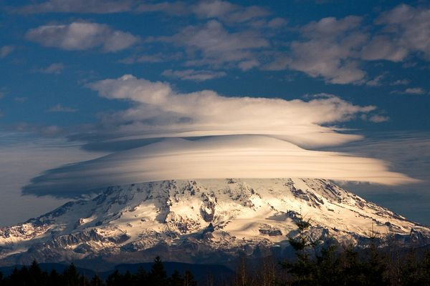
Chapter I

Slide 10
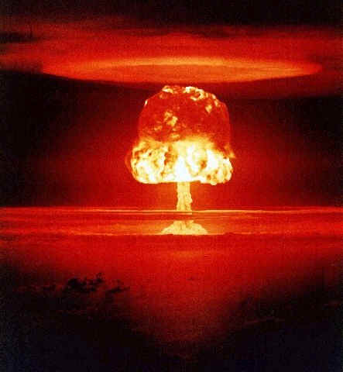
It blew up...that canister beam destroyeds the city...no...no it couldnt have been it couldnt...she destroyed it...
Let it go hunt...

Slide 11
HOW CAN I LET IT GO!!!
(both) do you want to take her on alone...

Slide 12
Yes i will now go!
k wll meetin the jungle ruins,the radar says thes a stone their...

Slide 13
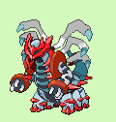
I KNOW YOUR THERE!
BOTH OF YOU!!
Your sister is in a form where she can not control her self unless i centarus,the underlord stay with her range to control her

Slide 14
I’ll kill you underlord for making her do this!
Why are you glowing....

Slide 15
Here have a look...have i disapointed...
I see you have become your super form...like chao mewblade...shall we start a battle!!

Slide 16
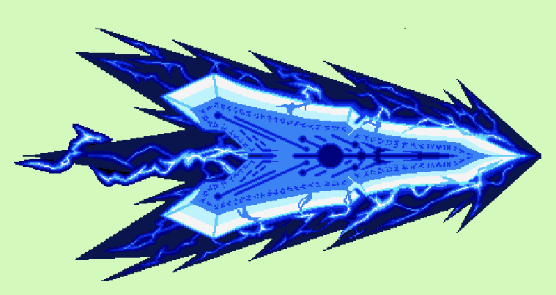
K.O!!
Super Hunt
Chaos mewblade
Super Hunt use canister beam
Chaos mewblade used Space blast
Super hunt used
Super blade
Chaos Mewblade used
Canister beam
Super hunt used Final blast!

Slide 17
Chaos Stones vol II

Slide 18
After the battle...mewblade and hunt were knock out after taking there damge from final blast,causing them both to become passive/no energy...underlord teleported without mewblade...leaving her to die...reznor and demisewan relized the battle was over,feeling no chi on thefelid they flew with help to revive him....
Chapter II

Slide 19
Lets take em to the jungle
Got it

Slide 20
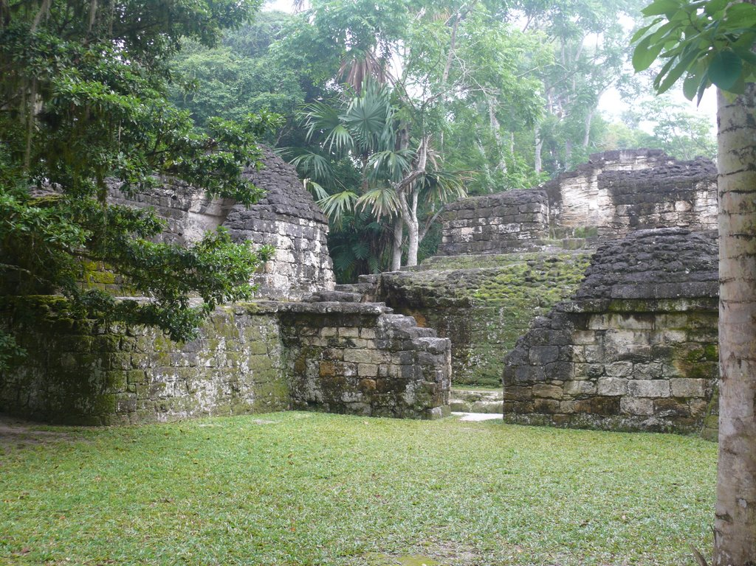
Are you two all right
yea
Look wat fell out of the sky wen you two bout fainted..and wat we found...

Slide 21
Hunt:were are the others
Mew:what others
Demise:mew...the others are our new team mates that are ment to help us stop the chaos world from getting destroyed
Mew:ok...brother..could you think of what they look like
Hunt:gladly

Slide 22
Mew:hold still

Slide 23
Mew:done...any of you sence that chi
All:yea

Slide 24
All:who are
I am cordem the great...give me those gems
all
Demise:never
Snot nosed kid...a battles wat you want a bttle you shall get

Slide 25
demisewan
Cordem
Demisewan used night shade
Cordem used space blast
Demisewan did nightshade

Slide 26
Cordem:you won how
Demisewan:i could fell your everymove..i’m phycic..i can hear your weaknesses stregnths everything
all
You can have this...
I thought he worked with underlord...why did he give it

Slide 27
Thanks for watching Chaos stones vol 1,every volume is two episodes...and thank you for the support V.L.K.

